Slide 1


Foundations of
Scientific Computing
(SciComp 101)
Dave Biersach
dbiersach@bnl.gov
Session 03
Making Line Graphs

Slide 2
Session 03 – Goals
Install the matplotlib package to create 2D and 3D plots in Python using its pyplot module
Create 2D line graphs by providing arrays containing the domain values and their corresponding range values
Understand the common standards for how Python source code should be formatted according to PEP 8
Install the Black package and plug-in for automated source code formatting in Thonny
Graph the divergence or convergence of infinite series
Generate two arrays of random integers and use vectorized operations to calculate Euclid's GCD between their values

Slide 3
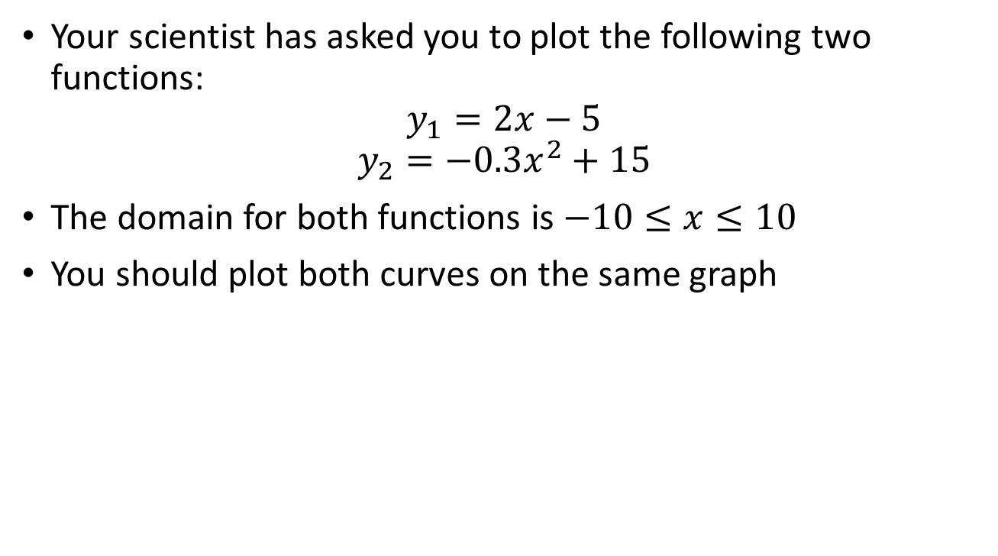
Line Graphs using matplotlib
Your scientist has asked you to plot the following two functions:
$$y_{1}=2x−5$$
$$y_{2}=−0.3x^{2}+15$$
The domain for both functions is $−10≤x≤10$
You should plot both curves on the same graph

Slide 4
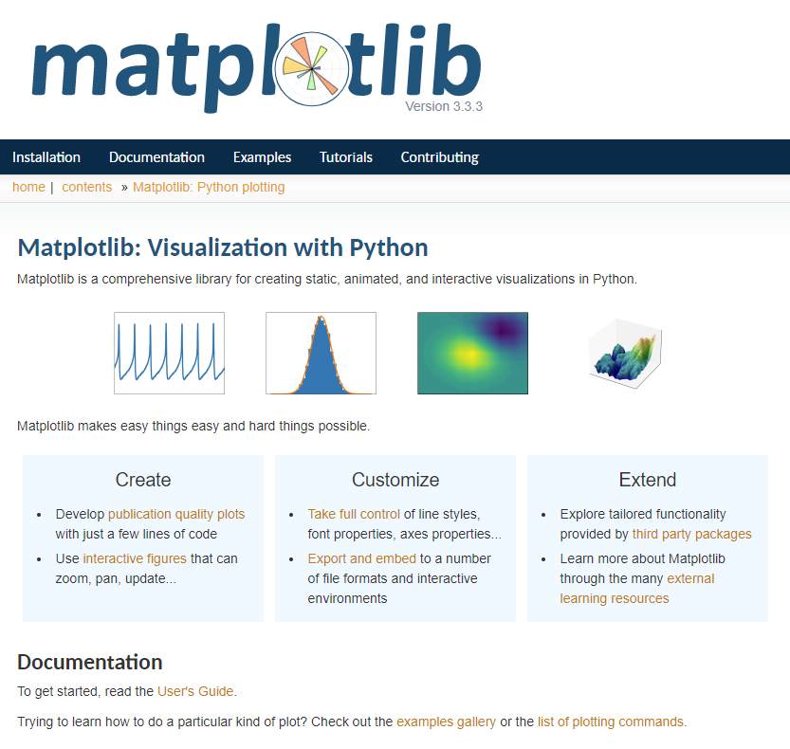
https://matplotlib.org

Slide 5
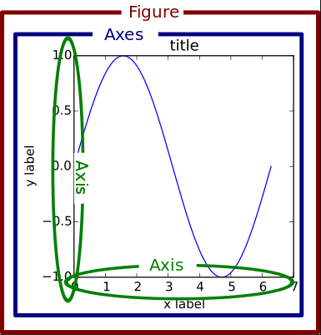
Matplotlib Container Hierarchy

Slide 6
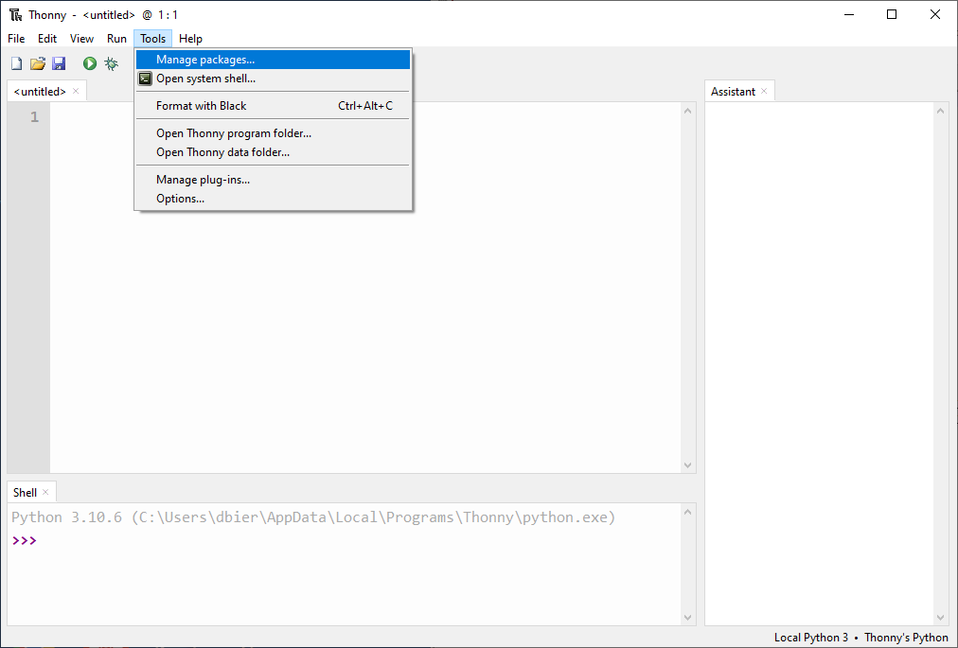
Installing Python Packages into Thonny

Slide 7
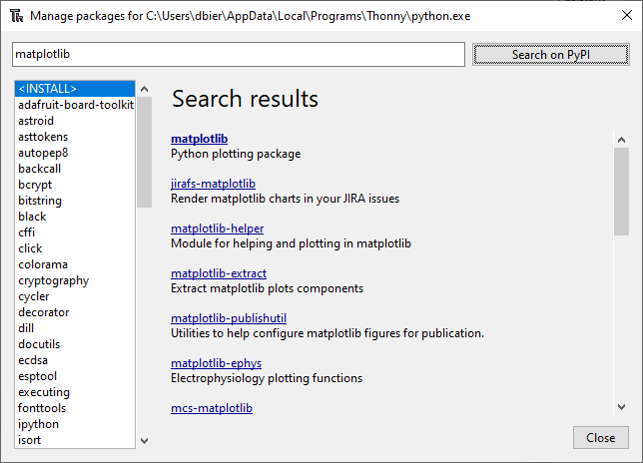
Find the matplotlib Package on PyPi

Slide 8
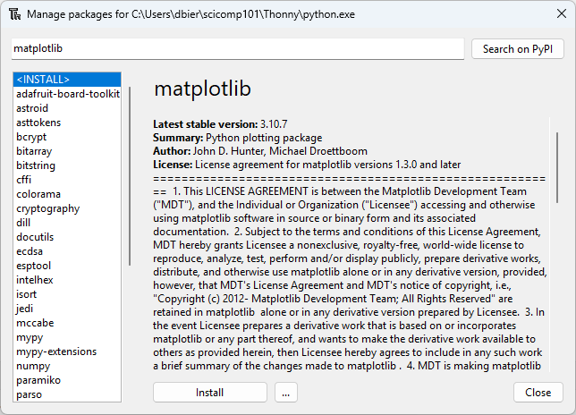
Install the matplotlib Package

Slide 9
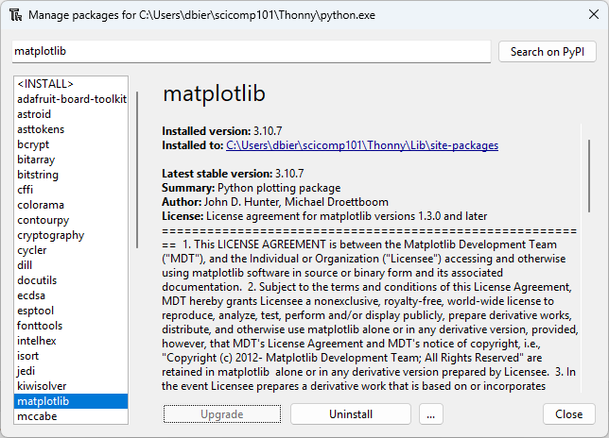
Verify the matplotlib Package Installation

Slide 10
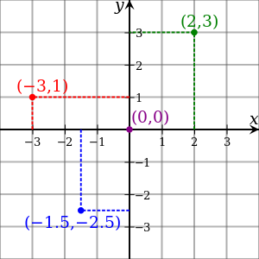
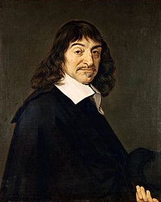
Cartesian Coordinates
Created by René Descartes in 1637

Slide 11
Line Graphs using matplotlib
Your scientist has asked you to plot the following two functions:
$$y_{1}=2x−5$$
$$y_{2}=−0.3x^{2}+15$$
The domain for both functions is $−10≤x≤10$
You should plot both curves on the same graph

Slide 12
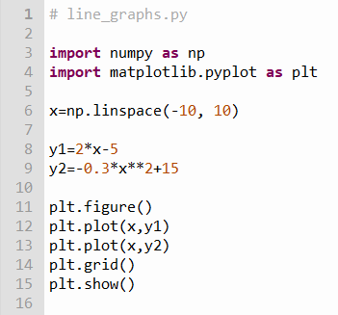



Edit line_graphs.py
①
②
③
$$−10≤x≤10$$
x is now an array containing 50 numbers between -10 and 10
④
$$y_{1}=2x−5$$
⑤
$$y_{2}=−0.3x^{2}+15$$
⑥
y1 and y2 are now arrays containing 50 numbers
⑦
⑧
⑨
⑩

Slide 13
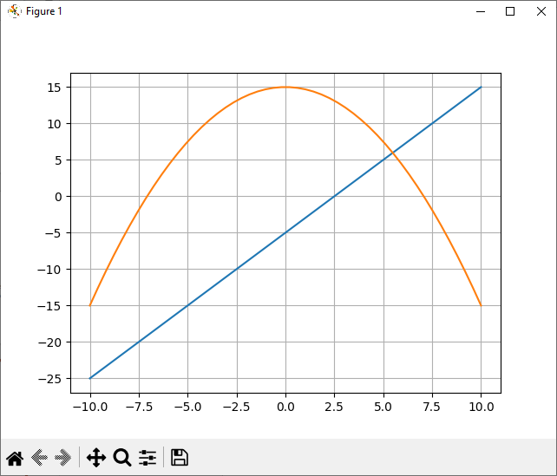
Run line_graphs.py

Slide 14
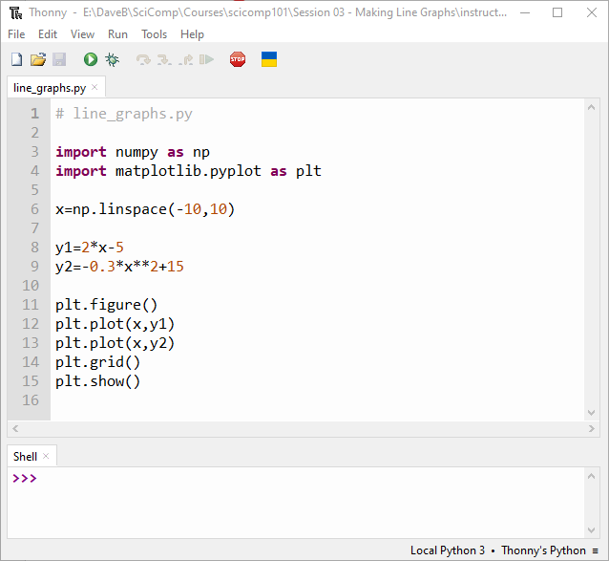
Properly Format Your Source Code
Adding spaces will make it easier for another programmer to read your code

Slide 15
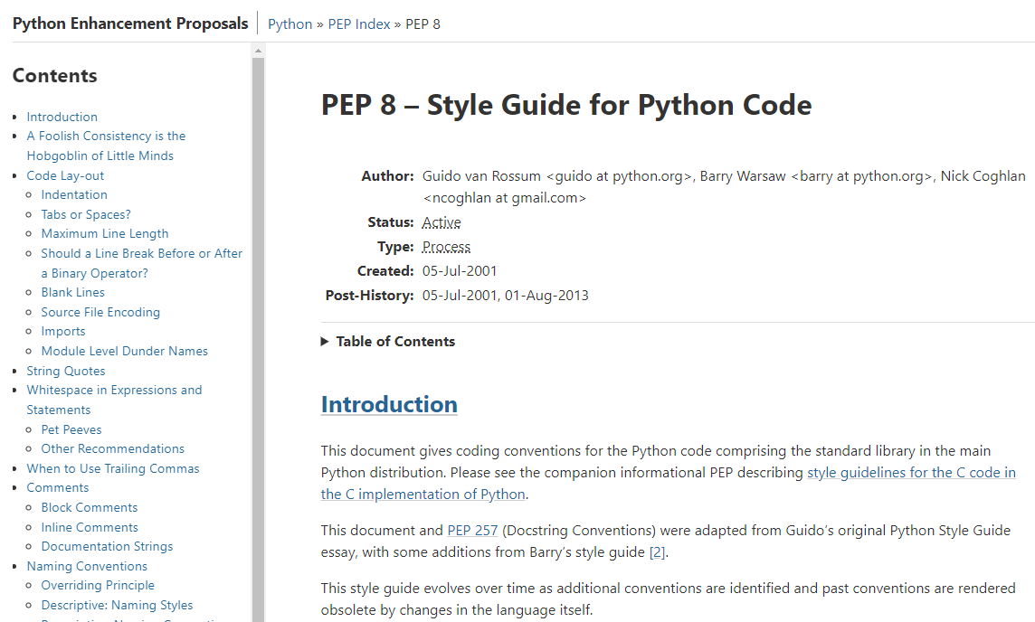
PEP 8 – Style Guide for Python Code
https://peps.python.org/pep-0008

Slide 16

The black Package
https://github.com/psf/black

Slide 17
Installing the black Package into Thonny

Slide 18
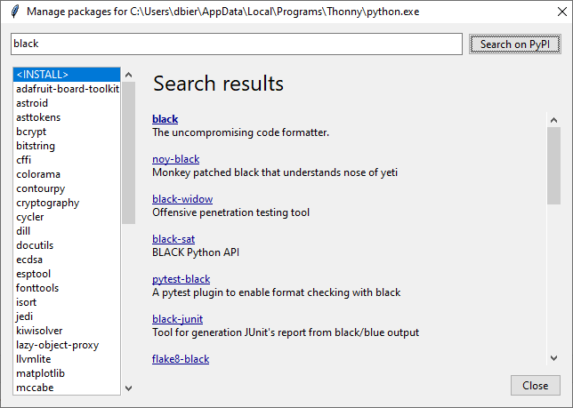
Search for the black package

Slide 19
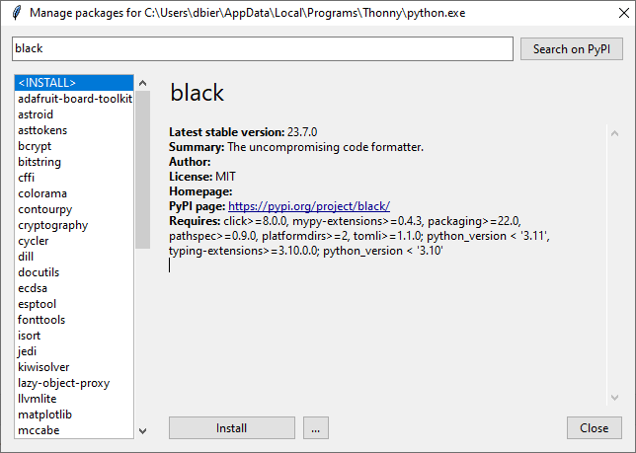
Install the black Package

Slide 20
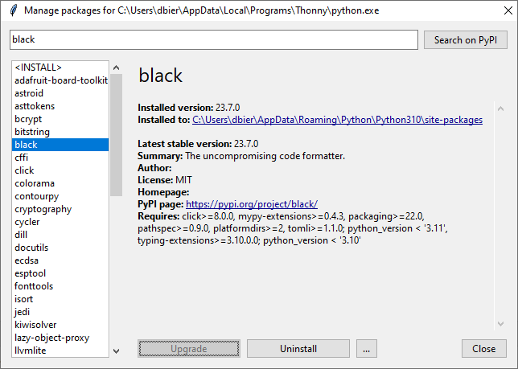
Verify the black Package Installation

Slide 21
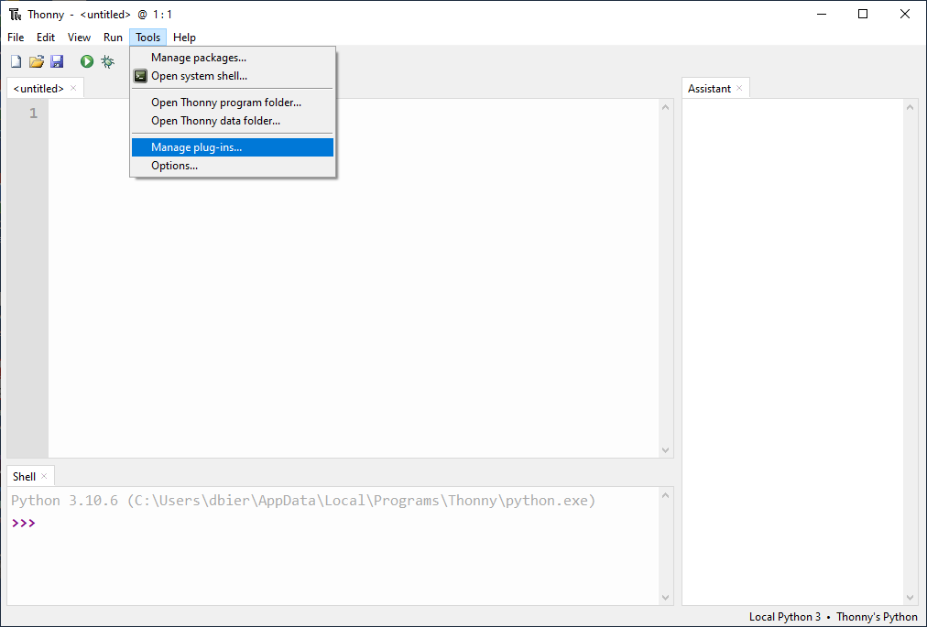
Installing Thonny plug-ins

Slide 22
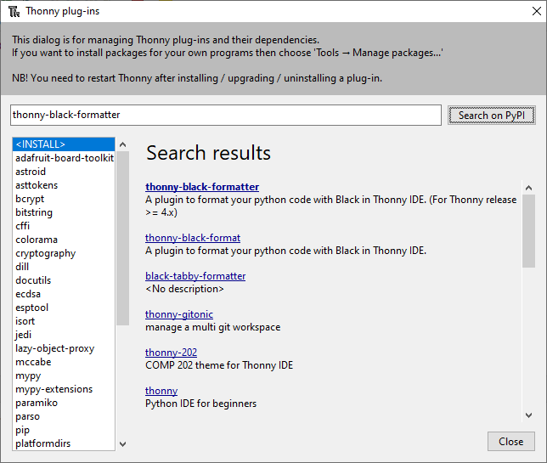
Search on PyPI and Select the plug-in name

Slide 23
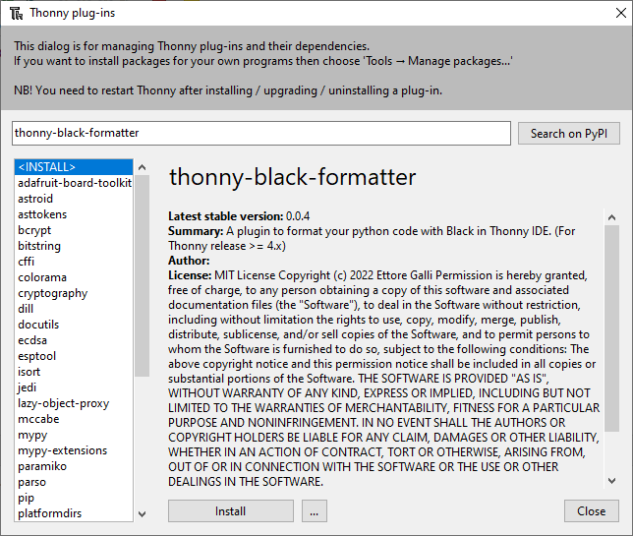
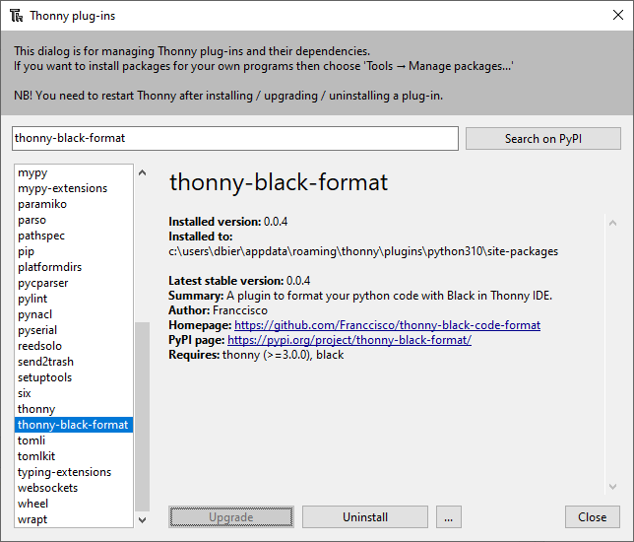
Install the thonny_black_formatter plug-in

Slide 24
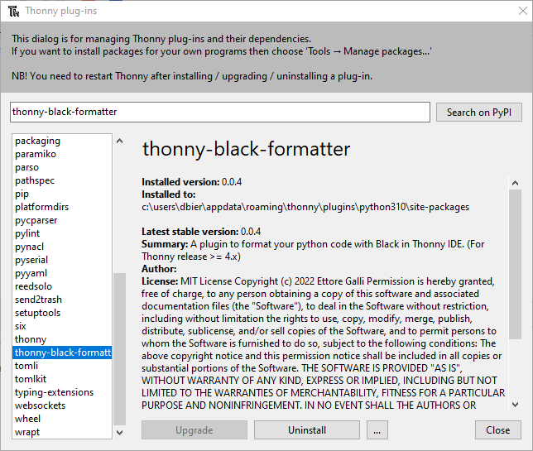
Verify the thonny_black_formatter plug-in

Slide 25
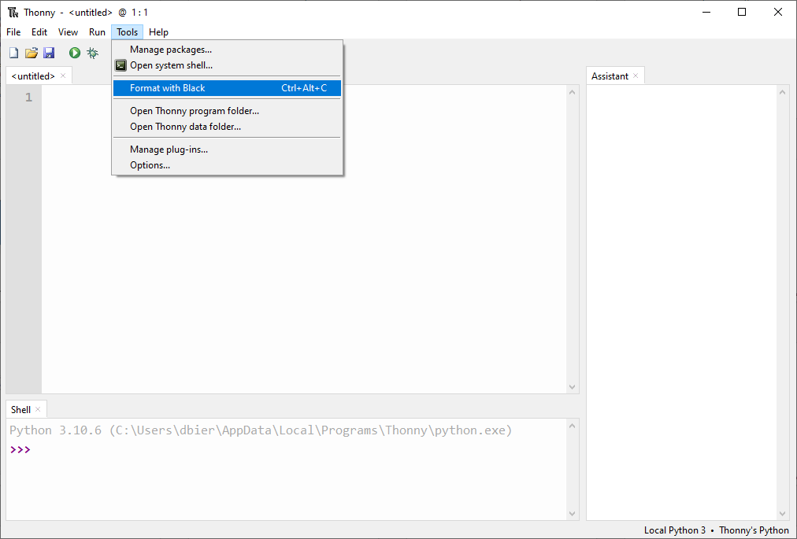
Restart the Thonny IDE to use a plug-in
You must RESTART Thonny for the Tools…Format with Black menu option to appear

Slide 26
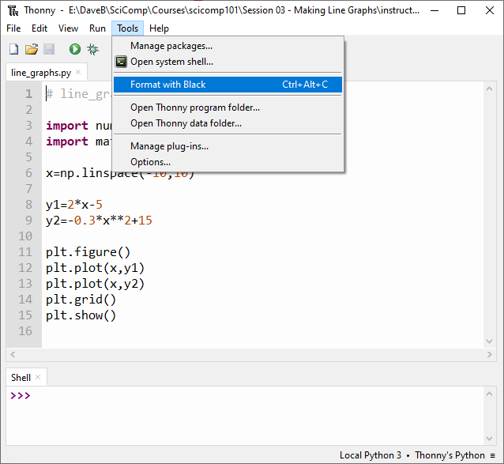
Format Your Code Following PEP 8

Slide 27
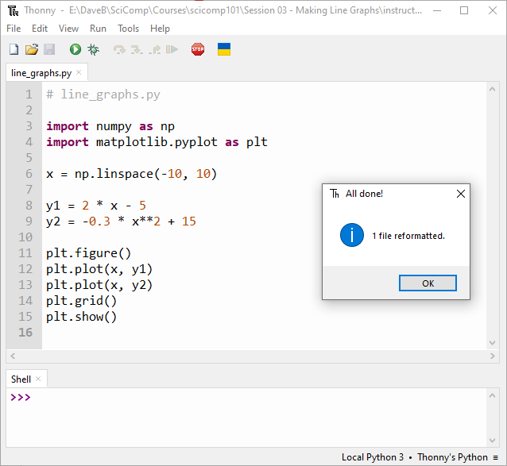
Format Your Code Following PEP 8

Slide 28
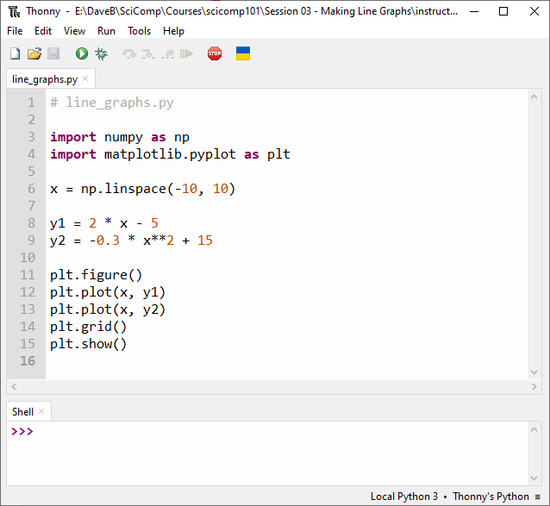
Format Your Code Following PEP 8
Always apply the Black formatting standard (PEP 8) to your code

Slide 29
Temperature Conversion
Your scientist has asked you to plot the Fahrenheit and Celsius temperature equivalents for temperatures in Kelvin that span from 0K to 400K
Your plot should label each temperature scale line graph so a legend can be added to the plot
As with all professional graphs, each axis should be labeled with the appropriate units
The graph should have a title and a grid for easier reading of the values
The research question is, "What is the one temperature that is the same in both Fahrenheit and Celsius?"

Slide 30
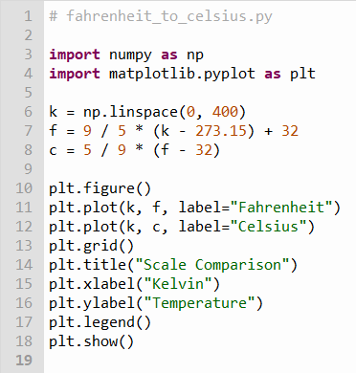
Open fahrenheit_to_celsius.py
Note: You should not edit this file!
①
②
③
④
⑤
⑥
⑦
⑧

Slide 31
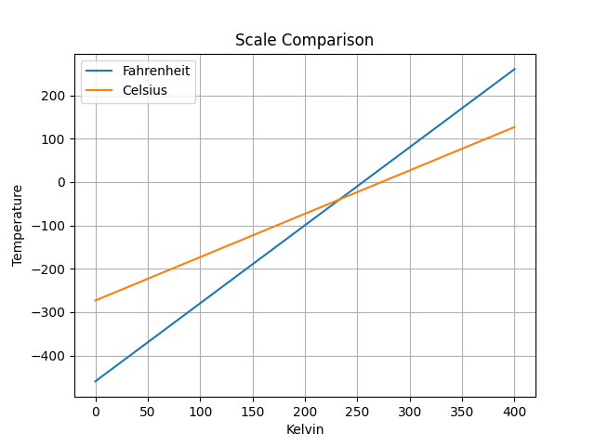

Run fahrenheit_to_celsius.py
$${−40}^{°}$$
What is the one temperature that is the same in Fahrenheit and Celsius?

Slide 32
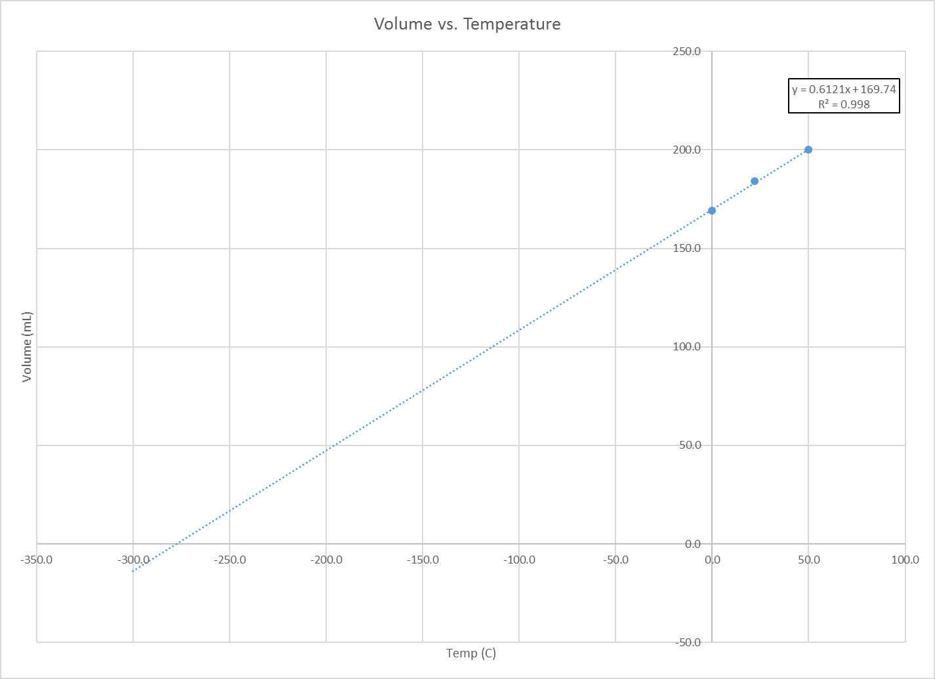
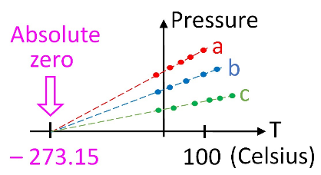
How did we calculate absolute zero in 1779? (PV = nRT)

Slide 33

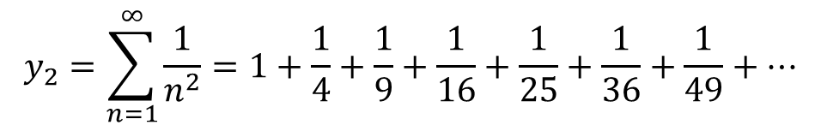
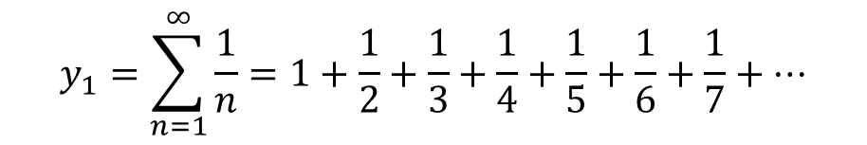
Infinite Series (Sums)
$$y_{1}=\sum_{n=1}^{∞}{\frac{1}{n}=1+\frac{1}{2}+\frac{1}{3}+\frac{1}{4}+\frac{1}{5}+\frac{1}{6}+\frac{1}{7}+…}$$
This sum is called the harmonic series
Does this series converge to a single value or diverge (grow without bounds)?
$$y_{2}=\sum_{n=1}^{∞}{\frac{1}{n^{2}}=1+\frac{1}{4}+\frac{1}{9}+\frac{1}{16}+\frac{1}{25}+\frac{1}{36}+\frac{1}{49}+…}$$
This sum is called the Basel series
Find the value of $\sqrt{{6y}_{2}}$ as $n→100,000$

Slide 34
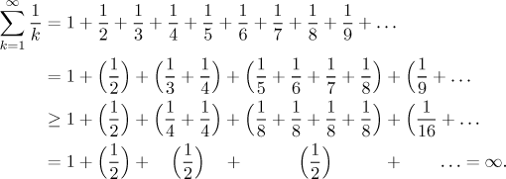
The Harmonic Series Diverges

Slide 35
The Harmonic Series Diverges

Slide 36
The Harmonic Series Diverges

Slide 37
The Harmonic Series Diverges

Slide 38
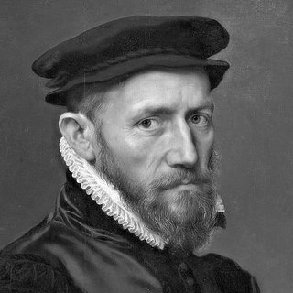
The Harmonic Series Diverges
The harmonic series diverges
Nicole Oresme (c. 1360)

Slide 39
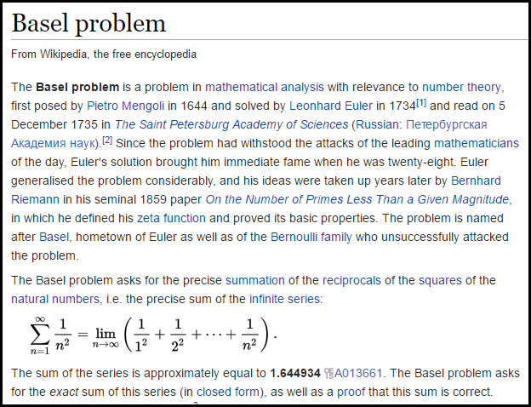

Slide 40
Infinite Series (Sums)
$$y_{1}=\sum_{n=1}^{∞}{\frac{1}{n}=1+\frac{1}{2}+\frac{1}{3}+\frac{1}{4}+\frac{1}{5}+\frac{1}{6}+\frac{1}{7}+…}$$
This sum is called the harmonic series
Does this series converge to a single value or diverge (grow without bounds)?
$$y_{2}=\sum_{n=1}^{∞}{\frac{1}{n^{2}}=1+\frac{1}{4}+\frac{1}{9}+\frac{1}{16}+\frac{1}{25}+\frac{1}{36}+\frac{1}{49}+…}$$
This sum is called the Basel series
Find the value of $\sqrt{{6y}_{2}}$ as $n→100,000$

Slide 41
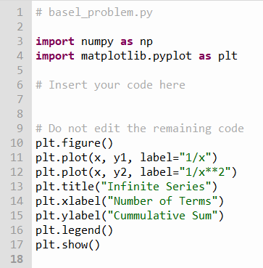
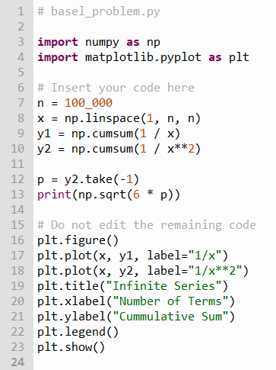


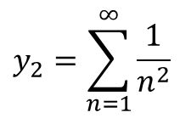
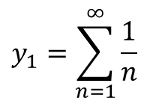
Edit basel_problem.py
①
②
③
④
⑤
⑥
$$n→100,000$$
$$y_{1}=\sum_{n=1}^{∞}{\frac{1}{n}}$$
$$y_{2}=\sum_{n=1}^{∞}{\frac{1}{n^{2}}}$$
$$\sqrt{6y_{2}}$$

Slide 42
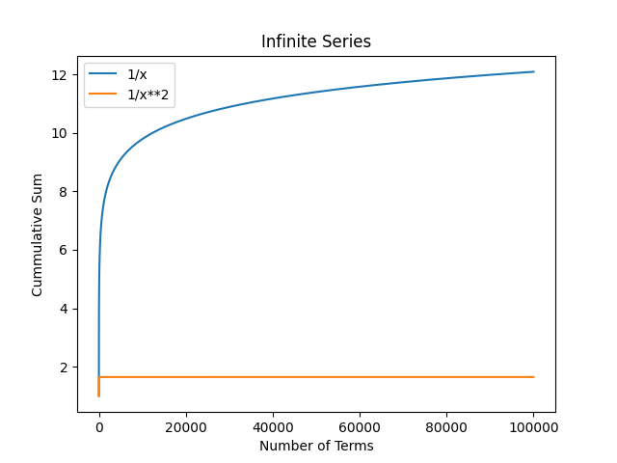

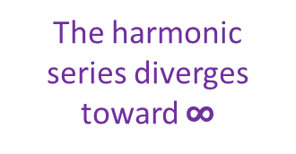
Run basel_problem.py
The harmonic series diverges toward $∞$
The Basel series converges to a specific number

Slide 43
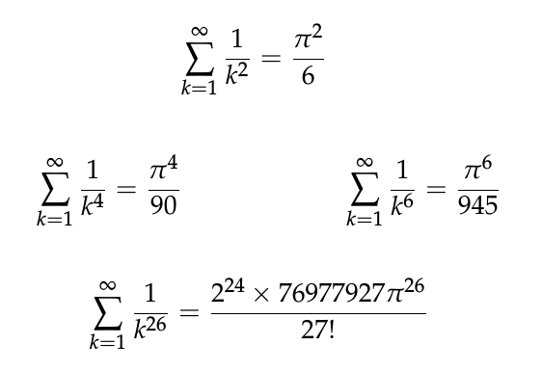
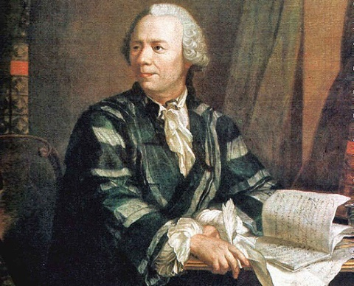
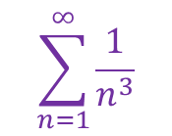
Run basel_series.py
Leonhard Euler
(1707 – 1783)
288 years later, we still do not know the exact value of
$$\sum_{n=1}^{∞}{\frac{1}{n^{3}}}$$

Slide 44
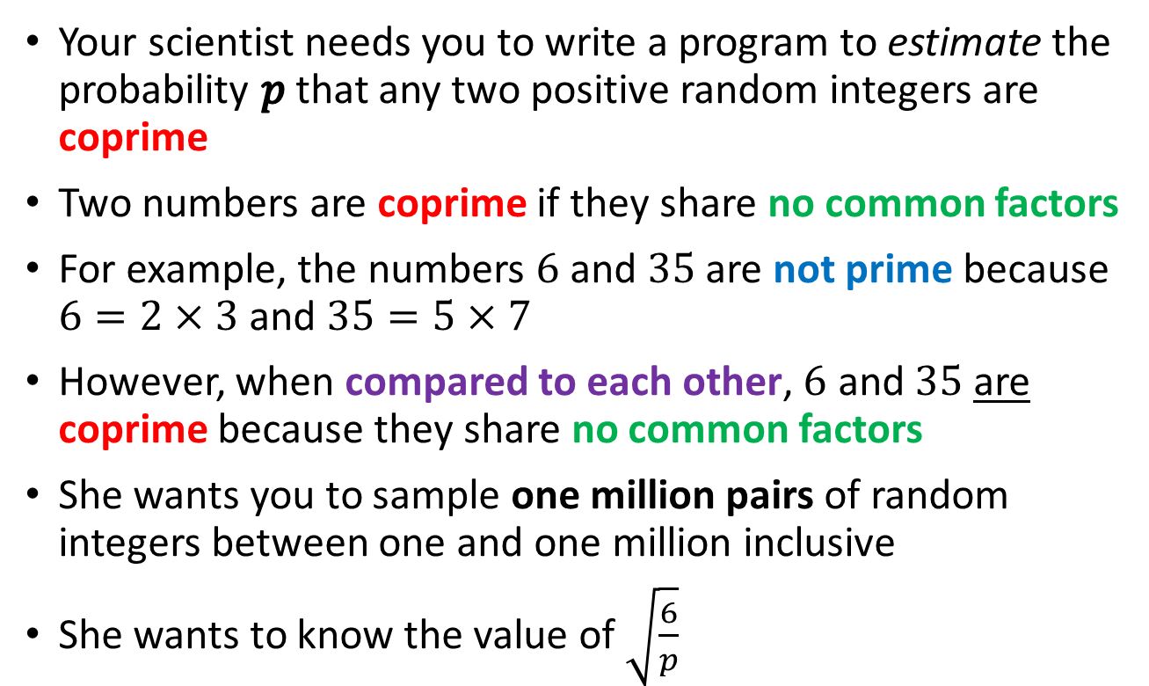
Coprime Probability
Your scientist needs you to write a program to estimate the probability $p$ that any two positive random integers are coprime
Two numbers are coprime if they share no common factors
For example, the numbers $6$ and $35$ are not prime because $6=2×3$ and $35=5×7$
However, when compared to each other, $6$ and $35$ are coprime because they share no common factors
She wants you to sample one million pairs of random integers between one and one million inclusive
She wants to know the value of $\sqrt{\frac{6}{p}}$

Slide 45
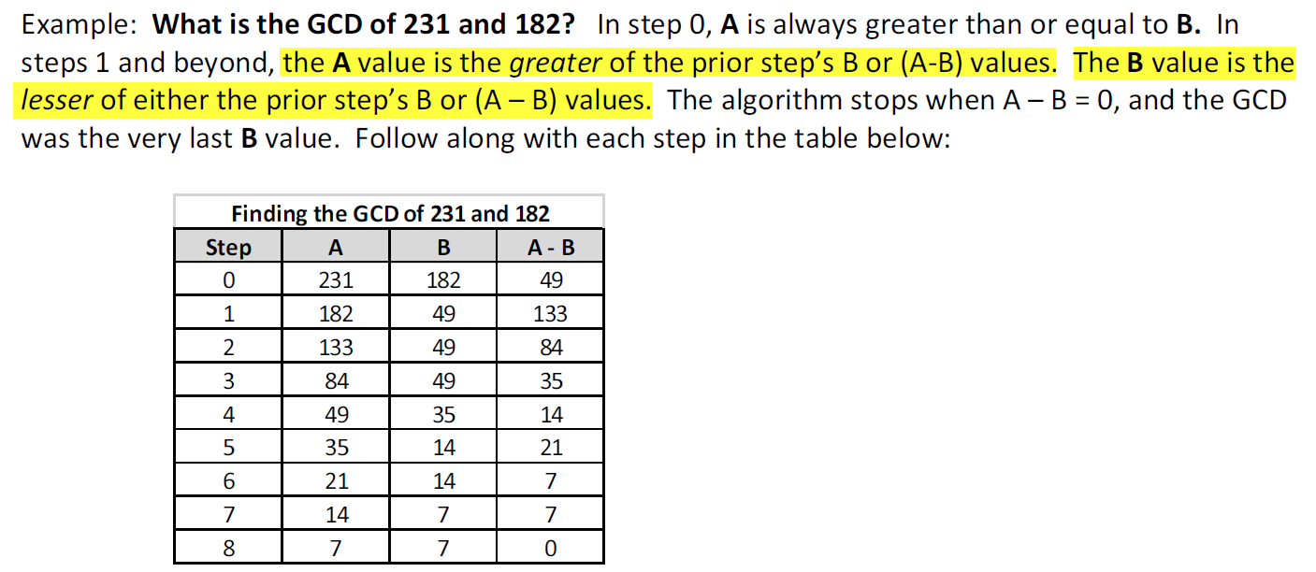
Greatest Common Divisor (GCD)
Greatest Common Factor (GCF)
What divides A and B must also divide the difference of A - B
Why?
Given {A, B, a, b, r} ∊ ℤ
$$A=a ∗r, B=b ∗r$$
$$\left(A −B\right)=a∗r −b ∗r$$
$$a −b= \frac{\left(A −B\right)}{r}$$
∴ One can determine the GCD without having to factor either of the two integers!

Slide 46
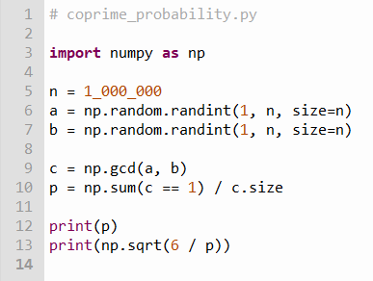
Open coprime_probability.py
Note: You should not edit this file!
①
②
c is now an array with one million elements
③
④
⑤
Probability is the number of times something did happen divided by the number of times it could have happened
If GCD(a, b) == 1 then a and b are coprime
⑥
a and b are arrays with one million elements
np.gcd() and np.sum() are vector "aware"

Slide 47



Run coprime_probability.py
The odds are greater than 50/50 that any two random integers are coprime
Leonhard Euler
(1707-1783)

Slide 48
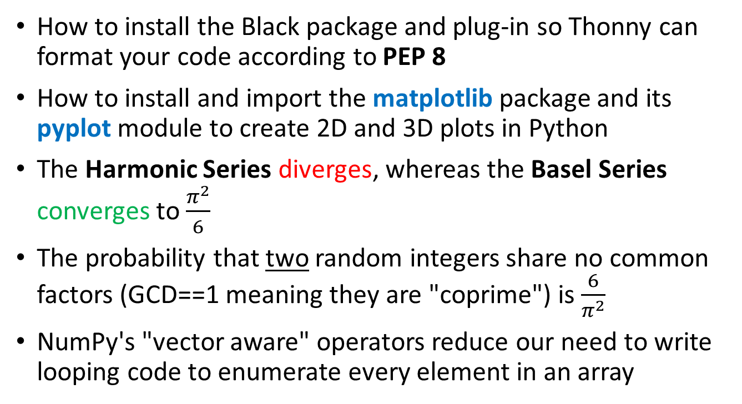
Session 03 – Now You Know…
How to install the Black package and plug-in so Thonny can format your code according to PEP 8
How to install and import the matplotlib package and its pyplot module to create 2D and 3D plots in Python
The Harmonic Series diverges, whereas the Basel Series converges to $\frac{π^{2}}{6}$
The probability that two random integers share no common factors (GCD==1 meaning they are "coprime") is $\frac{6}{π^{2}}$
NumPy's "vector aware" operators reduce our need to write looping code to enumerate every element in an array

Slide 49
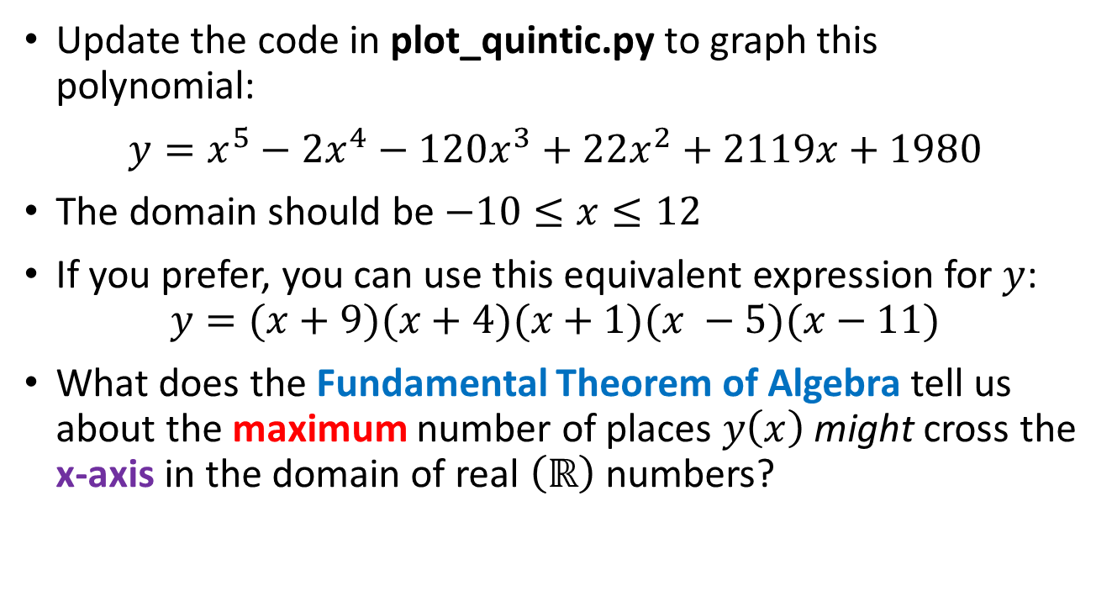
Task 03
Update the code in plot_quintic.py to graph this polynomial:
$y=x^{5}−{2x}^{4}−120x^{3}+22x^{2}+2119x+1980$
The domain should be $−10≤x≤12$
If you prefer, you can use this equivalent expression for $y$:
$$y=(x+9)(x+4)(x+1)(x −5)(x−11)$$
What does the Fundamental Theorem of Algebra tell us about the maximum number of places $y\left(x\right)$ might cross the x-axis in the domain of real $\left(ℝ\right)$ numbers?

